Slide 1
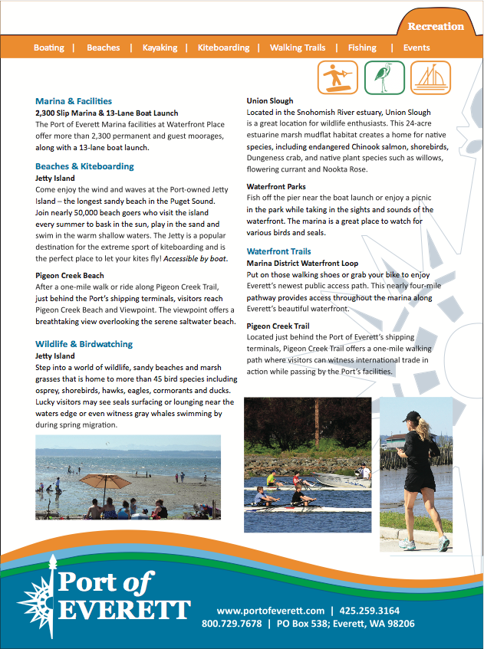
Port of Everett
Marketing Materials
Promotional/Advocacy Material

