Slide 1

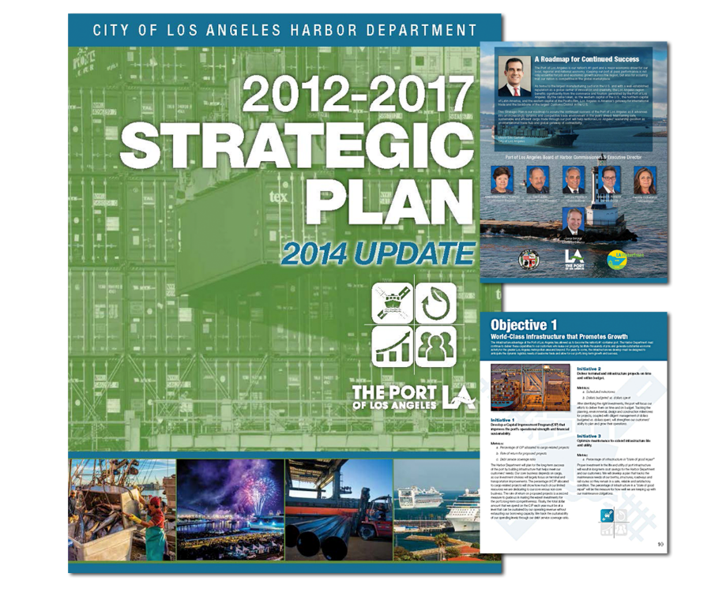
Port of
Los Angeles
2012-2017 Strategic Plan 2014 Update
Miscellaneous

