Slide 1
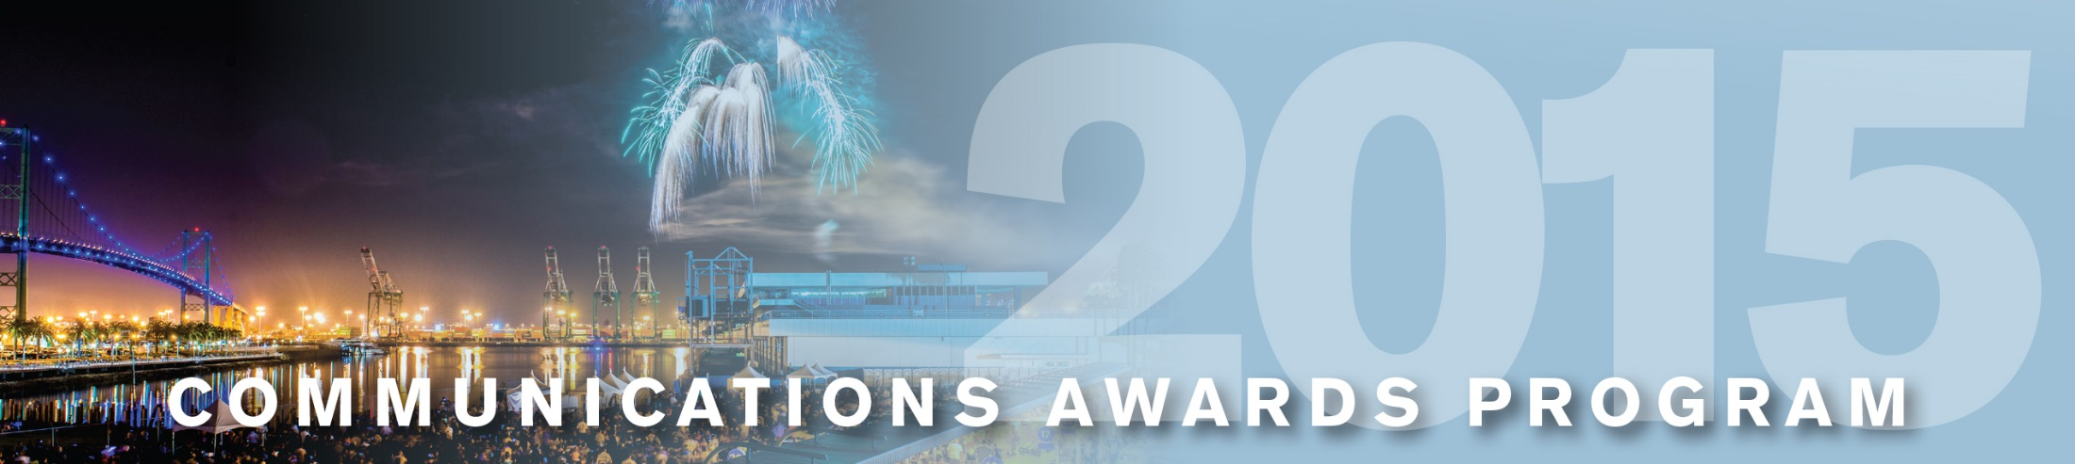
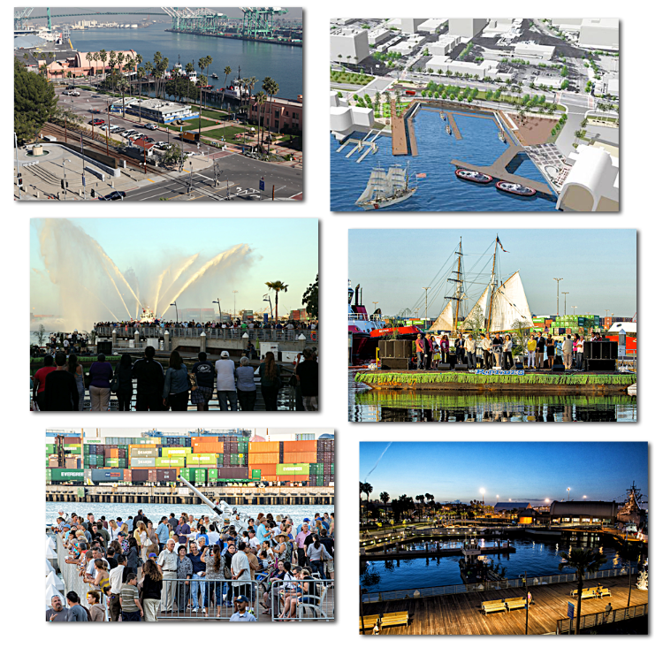
Port of
Los Angeles
Downtown Harbor
Grand Opening
Special Event

