Slide 1
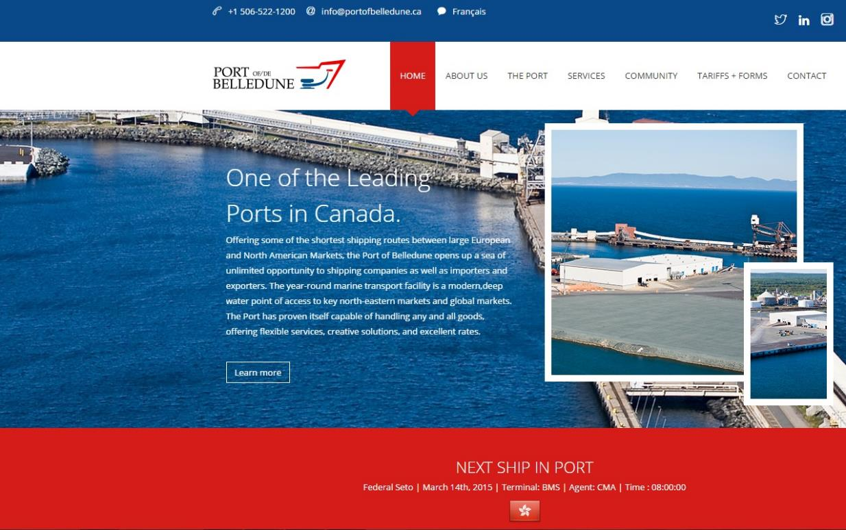
Belledune
Port
Authority
Belledune… Unlimited!
Websites
www.portofbelledune.ca

