Slide 1
Chemically Challenged Sediment Dredging in Los Angeles Jim Fields Los Angeles District USACE

Slide 2
What We Have Done/Tried
CAD Site Geo-tubes and Capping
Pilot Studies
Cement Stabilization
CAD Site
Sediment Washing
Sediment Blending
Sediment Separation
Upland
CDF’s

Slide 3
CAD Site Geo-tubes and Capping
One of our (LA District) first attempts at dealing with Contaminated sediments.
Lined dump scows with Geo-Fabric placed Contaminated sediment in the scow and sewed it up
Dumped the tube and buried it with clean cover material

Slide 4
Pilot Studies
WHAT ARE WE GOING TO DO???
Possible Alternatives for Future
Continue Marching Forward While Investigating
Cement Stabilization
CAD Site
Sediment Washing
Sediment Blending

Slide 5
Cement Stabilization
Add Cement or Fly Ash
Small Percent Great Geotechnical Result
Dry additive didn’t work, add in slurry form
Labor intensive
Fast acting
pH Change mobilized some metals
Bench testing required

Slide 6
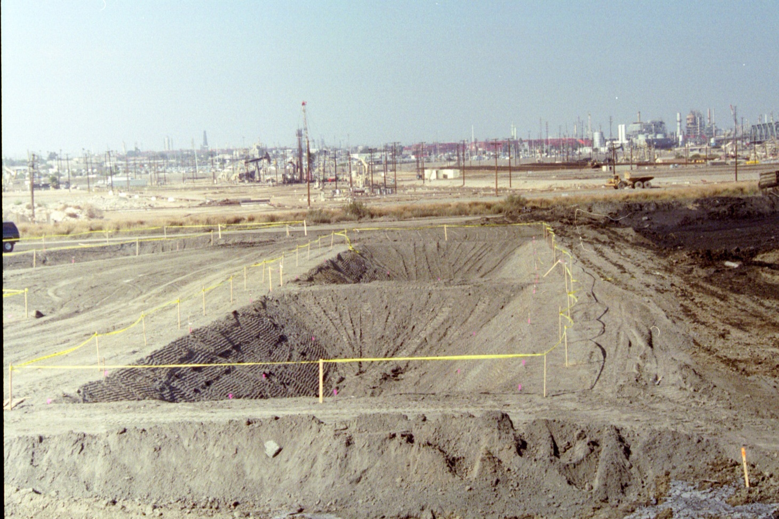

Slide 7
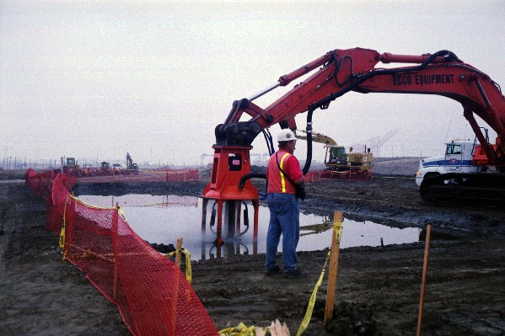

Slide 8
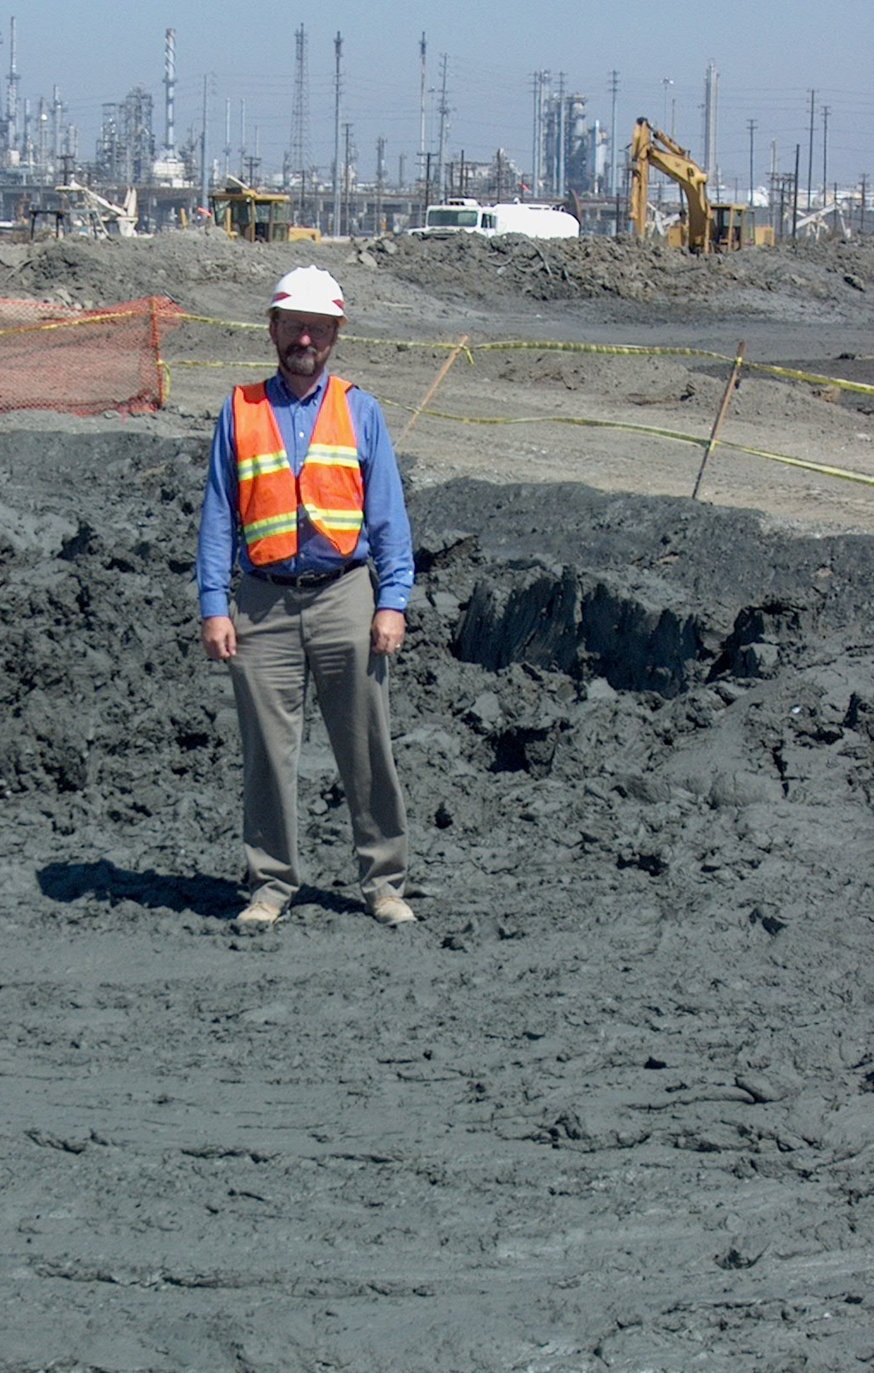

Slide 9
CDF’s
Easiest answer for now contaminants Removed from the Environment
Timing issues who has Envir. Clearances and Funding to match up with others schedules
Finite amount of space available
On-Site Coordination/Management objectives need to be met

Slide 10
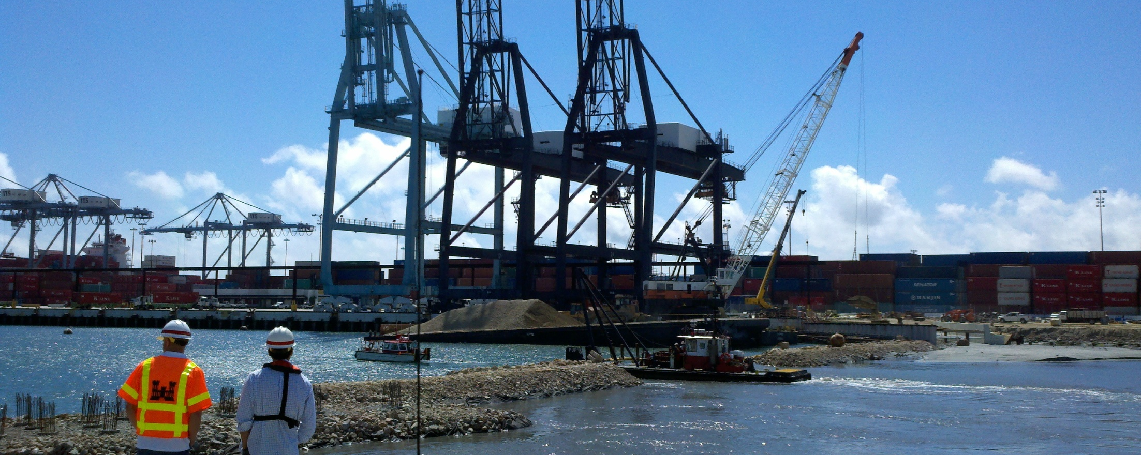

Slide 11
CAD Site
Great deal of opposition
If you remove once take it out
Lose quantity cost 25% removed at same price
Environmentally accepted other regions
Locations available
Small Pilot Test
Showed good results in subsequent monitoring
We still need a caretaker

Slide 12
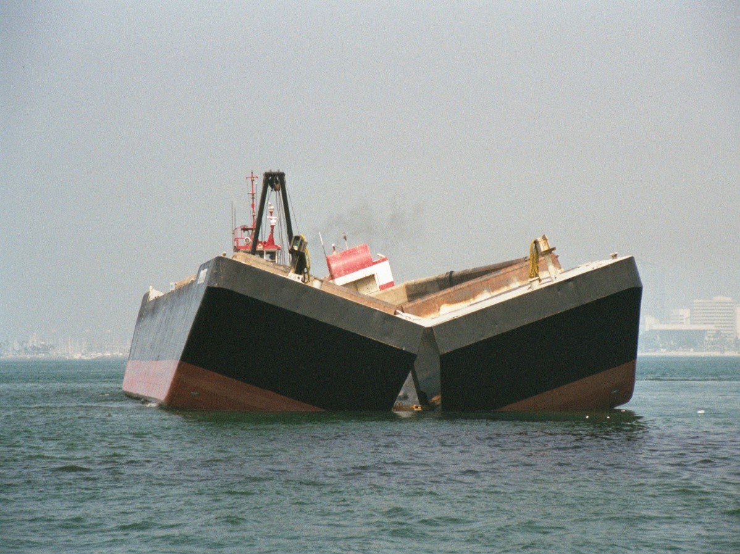
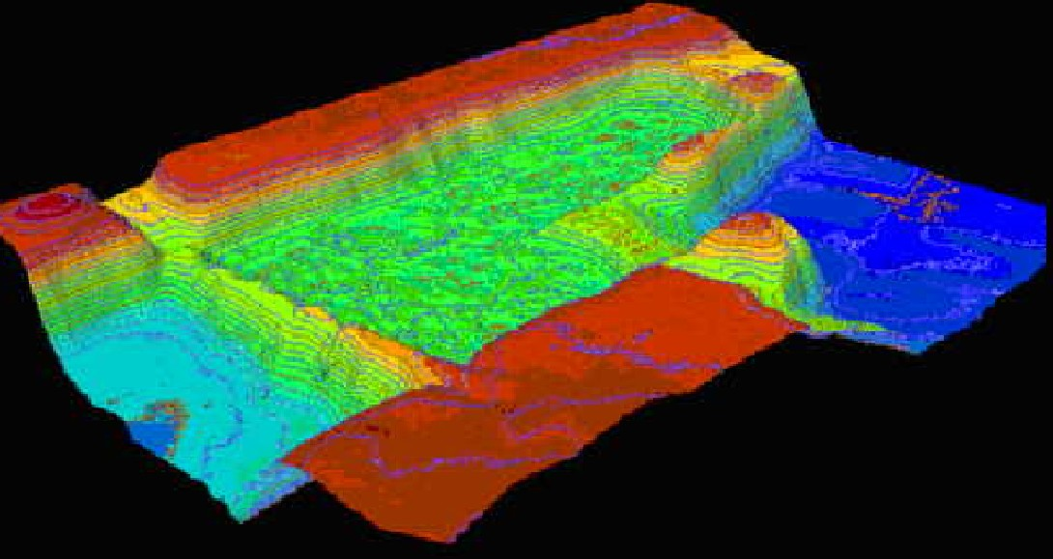

Slide 13
Sediment Washing Sediment Blending
These were both Bench scale and Litriture investigations
SW- Requires a large area and a lot of clean water to flush out contaminates as well as time for contaminants to dissociate/release
SB- Take Good Sediment and bad sediment and try to make a mediocre sediment out of it by mixing typically with bulldozers and discs

Slide 14
Sediment Separation
Initial stages of development
Contaminants bind to the Fines
Issues handling Trash & Organics
Volume leveling issues can’t keep up with big dredges
Getting other agency buy in
How clean is clean and by what basis
ER-L, ER-M, Trophic trace model

Slide 15
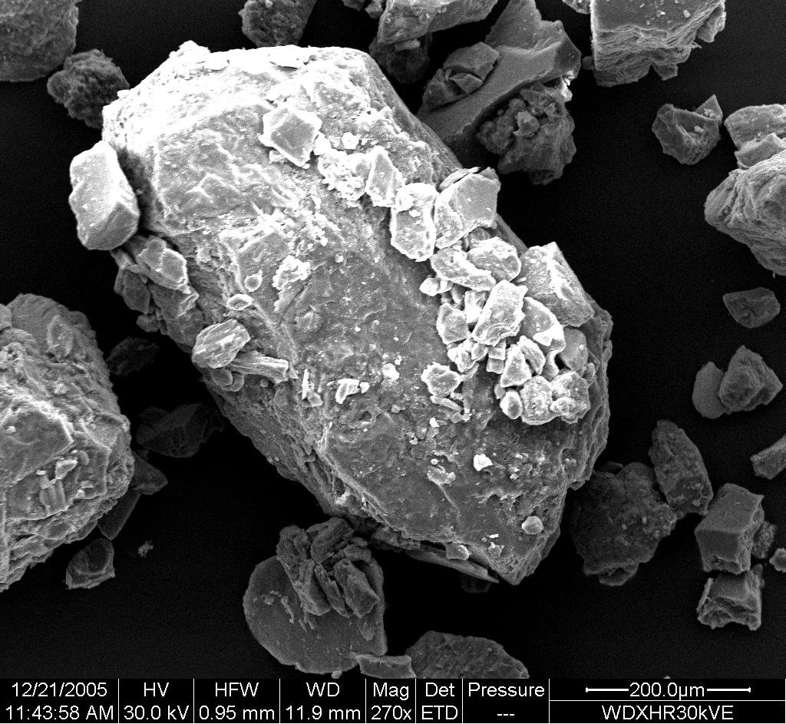

Slide 16
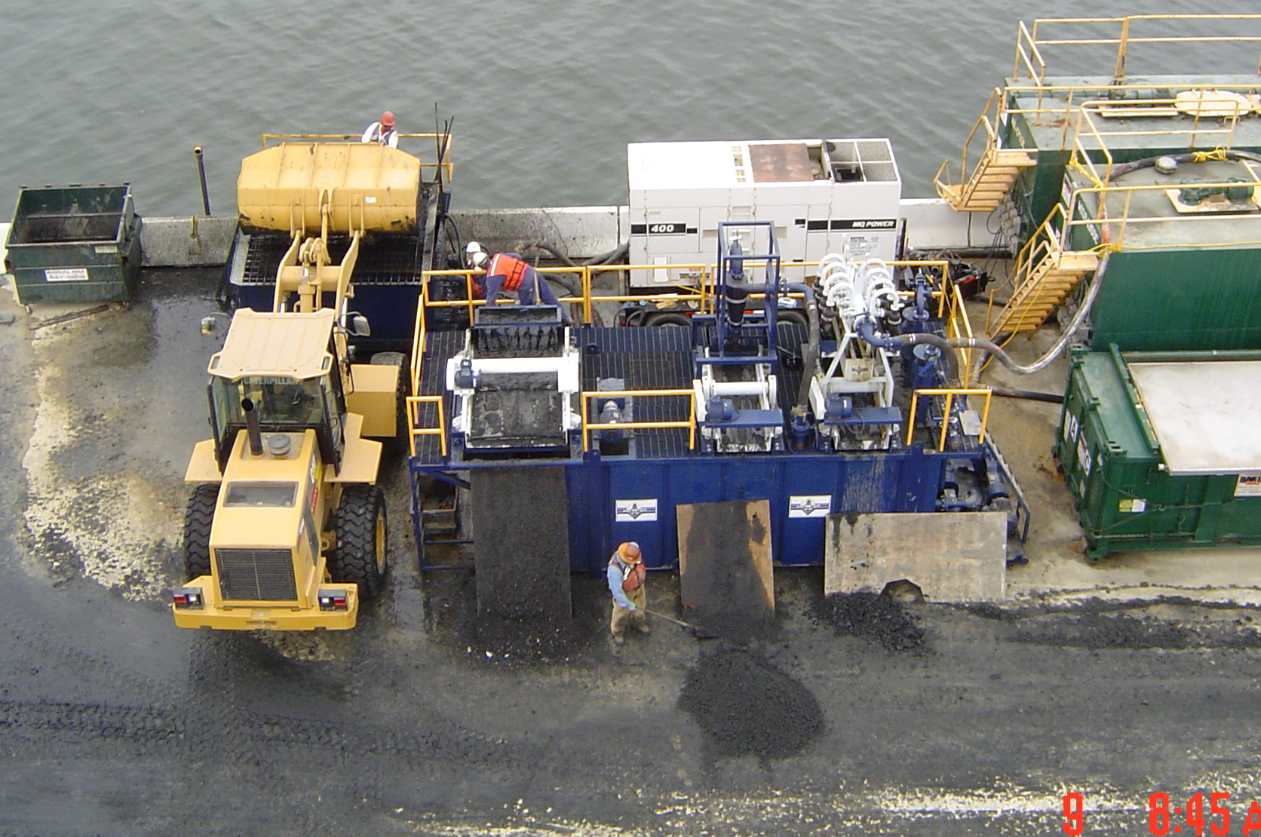

Slide 17
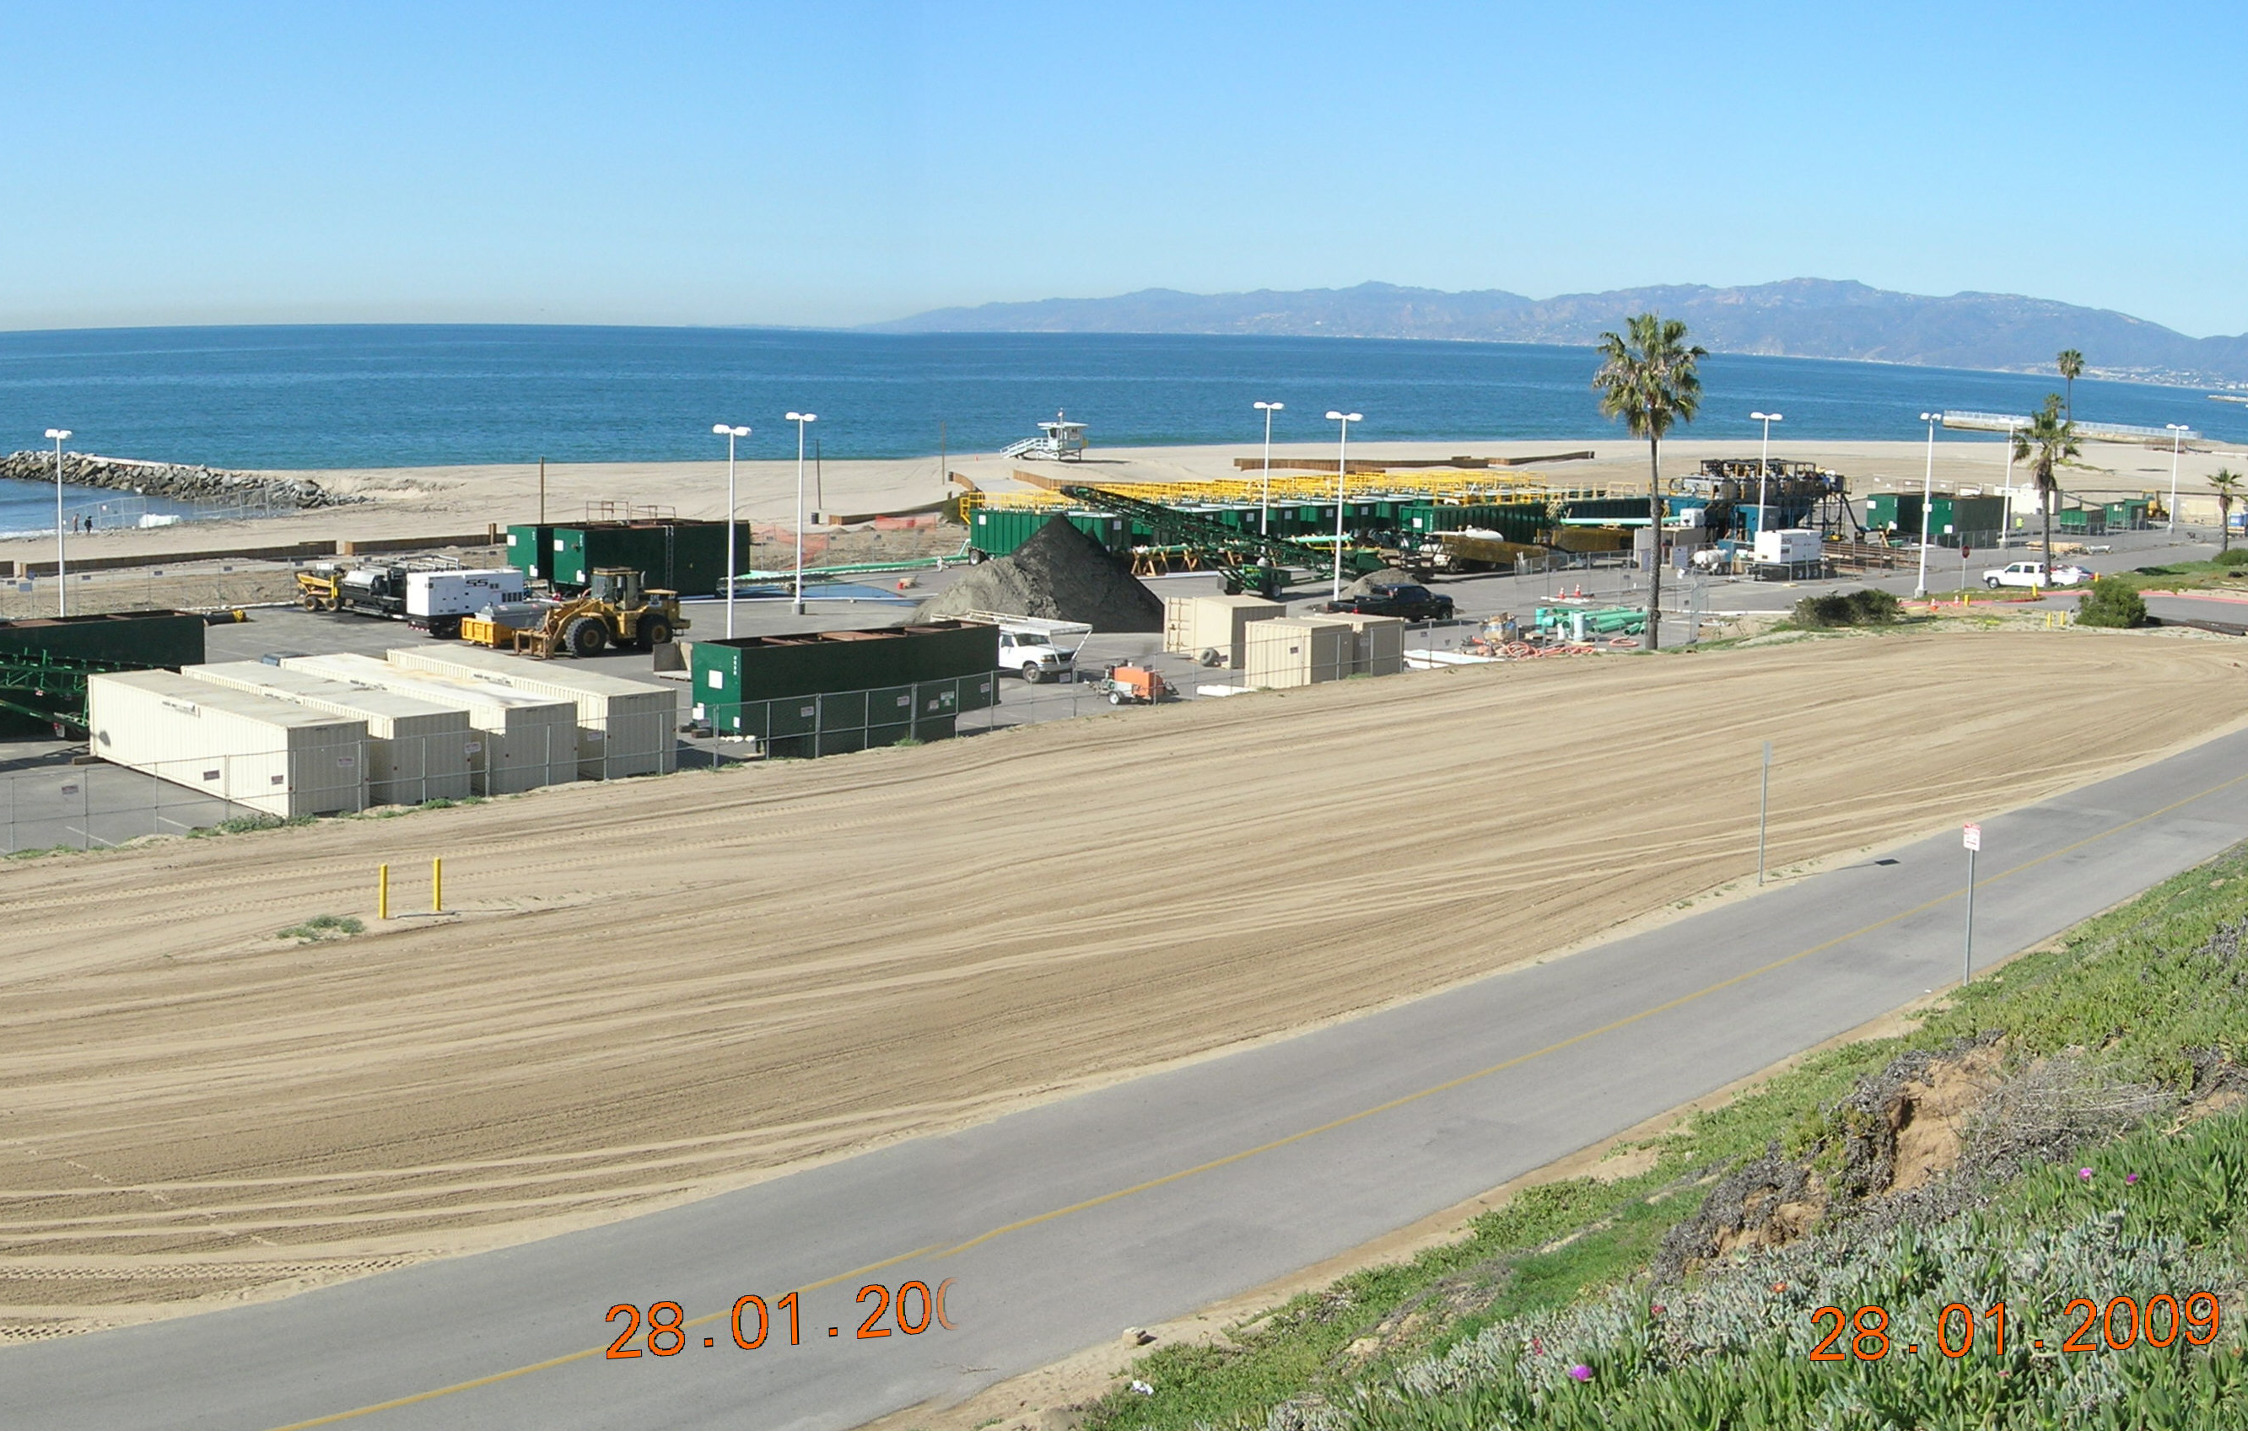

Slide 18
