Slide 1
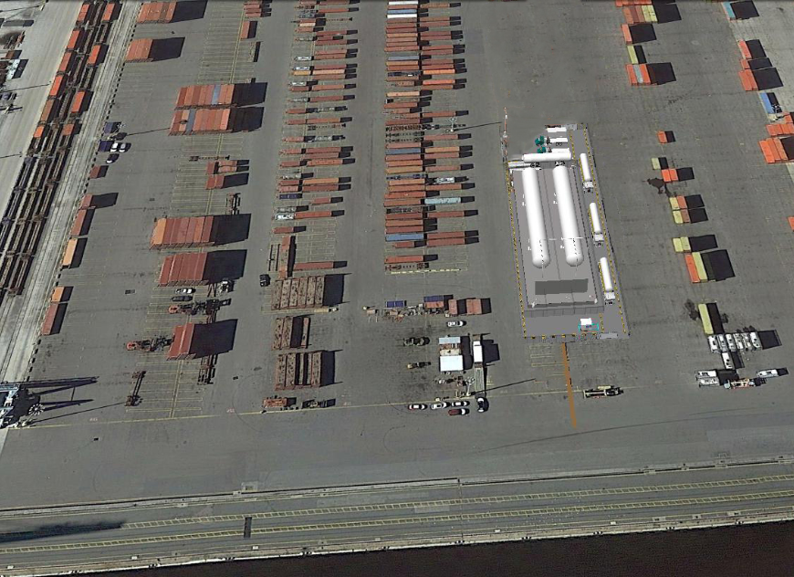
Eagle Talleyrand Terminal
In Service: Q3 2017
Storage Size: 500,000 Gallons
Scalable Storage Capacity

