Slide 1
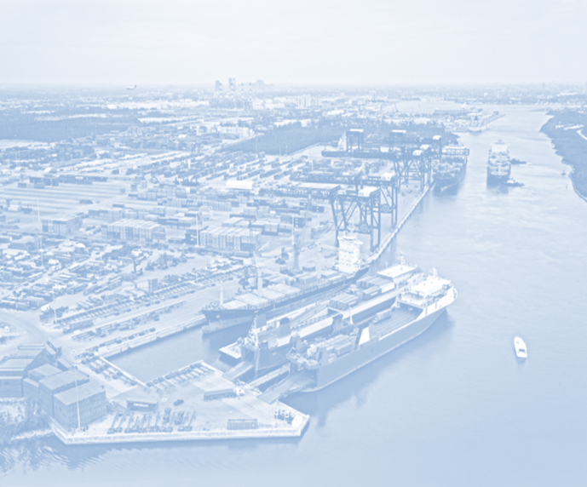
StrongPorts Initiatives - FY2014
Working with State Departments of Transportation, Metropolitan Planning Organizations, and ports to include water transportation in State and Regional freight and passenger transportation plans
A Collection of Investment Plan Best Practices and Tools, Developed by industry experts under a cooperative agreement between AAPA and the Maritime Administration
Notes:
The Maritime Administration’s StrongPorts Program is projecting a very busy 2014.
We have developed two initiative that will impact port projects and funding both inside and outside their gates. The First, which I want to mention only briefly, is our PortTalk regional maritime collaboration initiative.
PortTalk Collaborations are facilitated, day-long sessions where stakeholders from an individual State or region work together towards the development of their maritime transportation plans and projects.
During each PortTalk session, the Maritime Administration will help foster dialogue where there might not be one between State Departments of Transportation, Metropolitan Planning Organizations, ports, governor and mayors’ offices, congressional caucuses, and others with interests in seeing ports succeed.
We will identify shared needs and develop creative solutions to regional transportation challenges.
That said, I will move on to the topic of this sessions, which is the Port Investment Plan Toolkit.
This toolkit is going to be a collection of best practices and tools that ports can use to develop investment grade infrastructure improvement plans.

Slide 2
Port Planning & Investment Toolkit
Purpose
Help ports attract funding for projects to improve, modernize and expand their facilities
Develop a freely available, best practices toolkit for all ports
A joint venture between AAPA, a working group of industry experts, and the Maritime Administration.
The Working Group
Composed of approximately 55 technical experts
From ports, MPOs, universities, freight coalitions, operators, consulting, engineering, financial and legal firms
Notes:
The first natural question people ask when we bring up this project is why. Why are you pursuing this project?
In discussions with AAPA and individual ports, the Maritime Administration has heard that there is no authoritative source to help ports develop useful investment plans. We realized that we could help facilitative the filling of this gap but, as the federal government in Washington, DC, we are not the best organization to write the guidelines.
Thus, the toolkit effort has evolved into a joint venture between ports, private industry, and the federal government to develop port investment plans are useful and honest assessments of a ports current and future needs. It will provide guideline to interested ports that are developing plans to attract funds to improve, modernize, and expand their facilities. Best of all, the toolkit itself will be developed by the maritime industry, for the maritime industry. It will be your tool, as good or as bad as the effort that is put into it.
In order to ensure that the toolkit has the best available information, AAPA asked industry experts to volunteer for this effort as a part of a technical experts working group.
Their request was hugely successful, and AAPA has recruited 57 technical experts from ports and firms engaged in port planning, financing and development . . . to put together guidance on issues like attracting state, local, private and even federal financing . . . project risk management, public outreach, identifying optimal solutions to meet a port’s infrastructure or operational needs . . .
They come from ports, MPOs, universities, freight coalitions, operators, consulting, engineering, financial and legal firm, and they all understand that a set of investment plan best practices is in the interest of the whole maritime industry.

Slide 3
Port Planning & Investment Toolkit
Expected Outcomes
Clear, concise and functional investment grade plans
Clearly identify future port needs;
Determine the most cost-effective, sustainable and efficient solutions to port problems; and
Widespread use of industry developed plan elements and best practices.
Assist ports in obtaining funding
Have port infrastructure projects accepted into MPO and state transportation programs for formula funding eligibility;
Position port projects for federal funding such as TIGER grants; and
Assist ports in obtaining private sector investment funds.
Notes:
The working group will begin its efforts by writing a table of contents for an investment grade port investment plan, and they will then begin building tools and how-to guides for each chapter.
The completed toolkit will help raise the game of all our ports as they seek to fund needed infrastructure improvements.
Ports and port authorities will be able to use the toolkit to put their best foot forward and better attract funding with a clear, concise and functional investment grade plan. These plans will make a case for why specific port projects are investment worthy through clear descriptions of a ports future needs and markets as well as selling the proposed solutions. Best of all, the toolkit will provide a common language that ports can use to communicate with potential investors.
By ensuring that these plans are investment grade, we will give private investors the opportunity to augment limited federal funds while reaping the rewards of investing in our ports, which are a growth industry.
The completed toolkit will assist ports in obtaining funding by:
Improving their chances of getting port infrastructure projects in mpo and state transportation programs in order to receive formula funding;
Positioning port projects for federal funding such as tiger grants; and
Assist ports in obtaining private sector funding.
The goal is that this won’t be your aunt’s old strategic plan sitting on the shelf gathering dust.
This will be a working plan that actually draws joint venture public and private investments for specific port projects.
It will be very helpful for ports improving, modernizing and expanding their facilities . . . making it beneficial to our entire economy.
We’re hoping to have that done by the end of September.

