Slide 1
Liability Management – Evolving Cyber and Physical Security Standards and the SAFETY Act
JULY 17, 2014

Slide 2
Agenda
Security Risks affecting the Maritime Transportation System (MTS)
The SAFETY Act as an effective risk management tool
SAFETY Act coverage for physical security and cybersecurity practices
Questions

Slide 3
Importance of U.S. Ports to National Security and Economy
“Ports, waterways and vessels handle billions of dollars in cargo annually, and an attack on our nation’s marine transportation system could have dire consequences. Ports are inherently vulnerable to terrorist attacks because of their size, general proximity to metropolitan areas, the volume of cargo being processed, and the ready access the ports have to transportation links into the United States. An attack on a large port could also have a widespread impact on the broader global supply chain . . . and the world economy.”
Statement of Stephen L. Caldwell
Director, Homeland Security and Justice
Before the Committee on Homeland Security and Governmental Affairs, U.S. Senate
June 4, 2014

Slide 4
Security Risks affecting the MTS
Physical security risks are well-documented (terrorist attacks on ports and vessels, piracy, etc.)
Cyber-risks are less understood but are increasing in frequency and severity
MTS is not currently subject to mandatory cybersecurity regulation, but increased regulation could be imminent
Area, vessel, and facility security assessments all currently require consideration of radio and telecommunication systems, including computer systems and networks. This could become more prescriptive under the Maritime Transportation Security Act (MTSA)

Slide 5
IT Dependency Leads to Potential Vulnerability
Per GAO, port owners and operators rely on several forms of information and communications systems to operate
Terminal Operating Systems
Industrial Control Systems (ICS)
Business Operations Systems
Access Control and Monitoring Systems
Vessels rely on technologies such as GPS, marine Automatic Identification System (AIS), and Electronic Chart Display and Information System (ECDIS)
These technologies are not always secure and can lead to attacks and compromises.

Slide 6
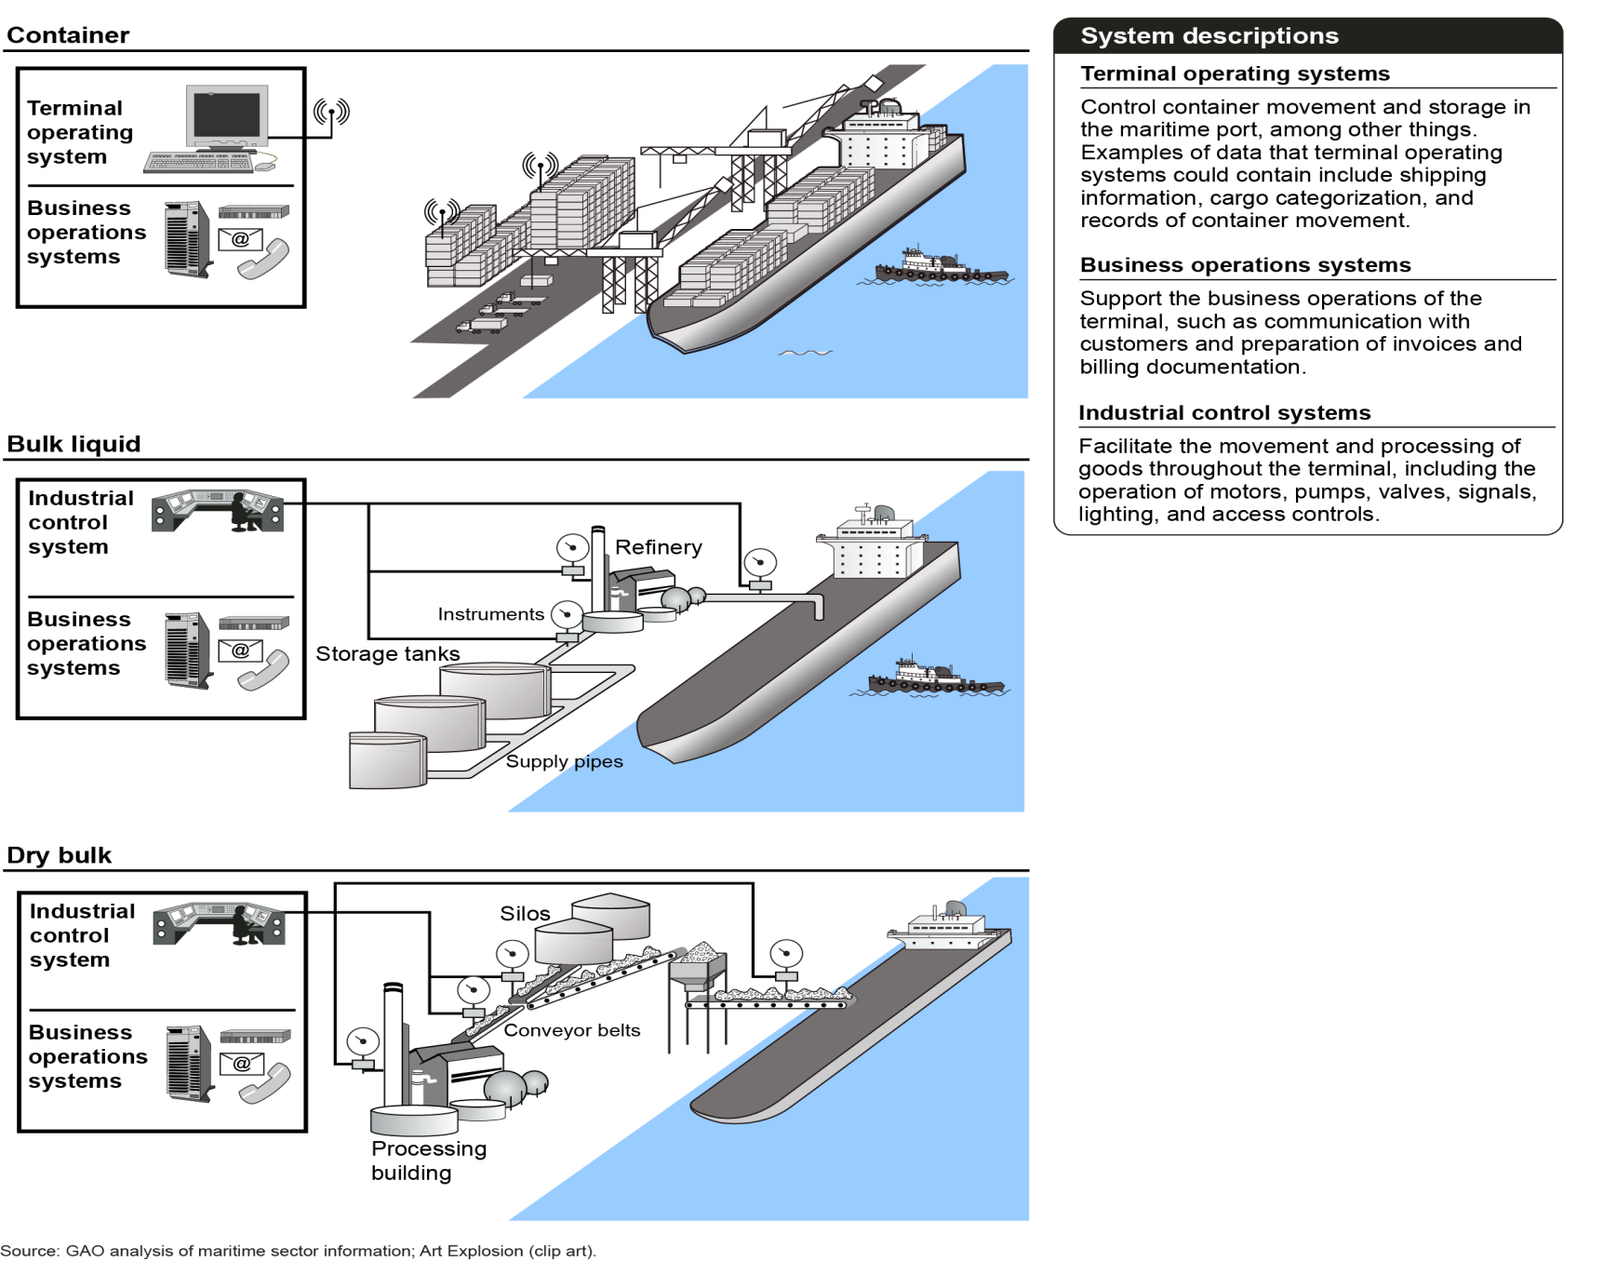
Examples of Technologies Used in Maritime Ports

Slide 7
Cyber Vulnerabilities Are Not Well Understood
A 2013 Brookings report found that only 1 of 6 ports reviewed had conducted vulnerability assessments; none had an incident response plan.
GAO reports that area maritime security plans (AMSPs) and facility security plans (FSPs) reviewed provided only limited consideration of cyber-risks
Guidance for developing AMSPs and FSPs to be updated in 2014 to require “basic” considerations of cyber issues

Slide 8
The Cyber Threat is Real
Per DHS, “the severity of cyber-related threats has only recently been recognized”
Actual attacks show that cyber-attacks are not merely hypothetical
Antwerp port hack
Oil rig attacks
Attacks on ships facilitated by data resulting from hack
Known vulnerabilities in ICS, GPS, AIS, and ECDIS could soon be exploited by threat actors (terrorists, organized crime, hacktivists, etc.)

Slide 9
Port of Antwerp – A Case Study
From 2011 to 2013, drug traffickers concealed an unknown quantity of heroin and cocaine with street value of over $210 million inside shipping containers
Traffickers recruited computer hackers to infiltrate IT systems at Port of Antwerp that controlled the movement and location of containers
Hackers e-mailed malware to staff at the Port that enabled hackers to get remote access; when malware discovered and removed, traffickers broke into offices and installed data interception hardware and key loggers
Armed with this information, traffickers located the containers, sent in drivers to pick them up, and erased the data to cover their actions

Slide 10
Stakes Are High
Economic impact of a successful attack could be substantial.
Per GAO, U.S. maritime ports handle more than $1.3 trillion in cargo annually
Cyber attacks against oil and gas infrastructure alone will cost energy companies close to $1.9 billion by 2018
Some attacks could also result in loss of life and/or environmental catastrophe

Slide 11
Why Worry About Cyber in the Absence of Explicit Regulation?
Lawsuits
Negligence
Breach of contract
Shareholder
Regulatory enforcement actions
Criminal actions
Share price considerations for public companies
Not to mention first party costs to contain reputational harm, etc.

Slide 12
The SAFETY Act
The SAFETY Act (Support Anti-Terrorism by Fostering Effective Technologies Act)
Enacted as part of the Homeland Security Act of 2002, Public Law 107-296 (Title VIII, Subtitle G, Secs. 861-65)
Implementing regulation at 6 C.F.R. Part 25
Intended to encourage the development and deployment of anti-terrorism technologies by creating systems of “risk” and “litigation management”
Technologies include:
Products, devices, equipment
Services – both supporting and stand alone services
Cyber-related items
Information technologies and networks
Integrated Systems

Slide 13
Scope of the Act
Applies to an “act of terrorism,” which is may include cyber terrorism
An “act of terrorism” is defined by DHS as:
Unlawful
Causes harm, including financial harm, to a person, property, or entity, in the United States…; and
Uses or attempts to use instrumentalities, weapons or other methods designed or intended to cause mass destruction, injury or other loss to citizens or institutions of the United States
Includes attacks committed by domestic terrorists
May include attacks on foreign soil, if harm is to a person, property or entity in the United States

Slide 14
Levels of SAFETY Act Protection
Certification
High degree of confidence in continued effectiveness
Designation
Proven effective
Developmental, Testing and Evaluation Designation (“DTED”)
Additional evidence needed to prove effectiveness

Slide 15
Benefits of Protections
Certification | All the benefits of Designation Government Contractor Defense
Designation | Liability cap at a pre-determined insurance level Exclusive jurisdiction in Federal court Consolidation of claims No joint and several liability for noneconomic damages Bar on noneconomic damages unless plaintiff suffers physical harm No punitive damages and prejudgment interest Plaintiff’s recovery reduced by collateral sources
DTED | Same as Designation, but for a shorter duration (3 yrs)

Slide 16
Obtaining SAFETY Act Protections
Internal Assessment of Technology
- Document
-Enhance
Prepare Application
Submit Application to OSAI
The Applicant’s Role
Completeness Review (30 days)
Technical & Economic Review / Requests for Information
DHS Decision
OSAI/DHS’s Process
OSAI/DHS Review Time = 120 days (total)

Slide 17
SAFETY Act Coverage of Physical and Cyber Security Plans
SAFETY Act covers products and services that a seller provides to others and itself, i.e. its own physical and cybersecurity programs.
Covered entities are encouraged to base their programs on accepted standards, particularly in the cyber context, in order to:
Provide a baseline against which practices can be compared for purposes of application
Corroborate that the plan is effective and otherwise reasonable

Slide 18
Choosing the Right Standard
In most instances, entities will have an array of guidelines, standards, and frameworks from which to choose.
Main criteria is reputation and wide level of acceptance
Often indicated by ANSI accreditation, propagation by trusted sources, etc.
In some cases, regulations may be used as the basis for a program

Slide 19
The NIST Cybersecurity Framework
In the cyber context, implementation of the NIST Cybersecurity Framework is highly encouraged as part of the program sought to be covered by the SAFETY Act.
Developed per direction of EO 13636
Emphasizes risk management
Flexible and scalable
Relies on existing standards, guidelines and other resources to achieve desired security outcomes.

Slide 20
The Framework is a Good Fit for MTS
OSAI is part of DHS, which is responsible for the voluntary program associated with Framework (C-Cubed)
Coast Guard “strongly encourages” review of Framework in ALCOAST 122/14 and is seeking feedback on its applicability to the MTS.
FEMA’s 2014 Port Security Grant Program guidance encourages applicants to propose projects to assist in implementing Framework

Slide 21
SAFETY Coverage Makes Business Sense
Even in the absence of an act of terrorism, the SAFETY Act provides numerous benefits:
Lower insurance premiums
Gov. approval of security program can serve as a defense against lawsuits
Gov. seal of approval can be a boon in the marketplace
By purchasing SAFETY covered technologies/services, entities can also receive additional liability protections.

Slide 22
Questions?

