Slide 1
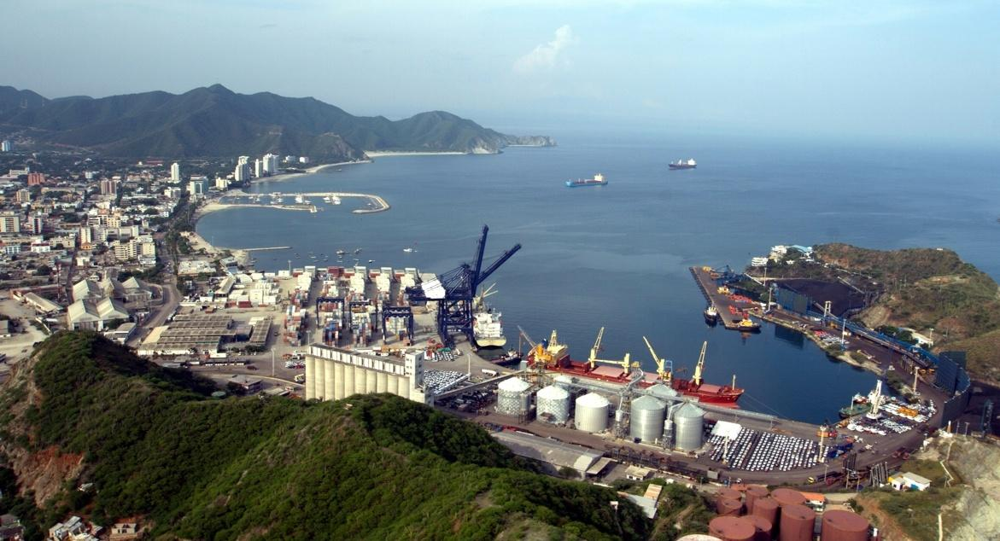
«Communicating sustainable development of a port terminal in the heart of the most beautiful Colombia’s bay»
Camilo George Díaz,
Head Communications Port of Santa Marta, Colombia
Notes:
-Good afternoon to all present, my name is Camilo George Díaz, Communications Director of the Port of Santa Marta. I thank you for the opportunity to tell the communications committee a little of what we do to protect the environment, the work with the communities in our port operations, especially in the reception, collection and loading of coal and how we communicate this sociar responsability . I apologize for some failures there may be in my English, but I will make every possible effort to speak the best I can.

Slide 2
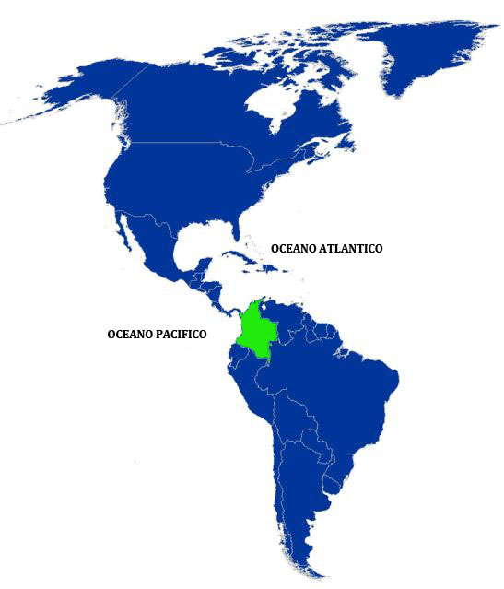
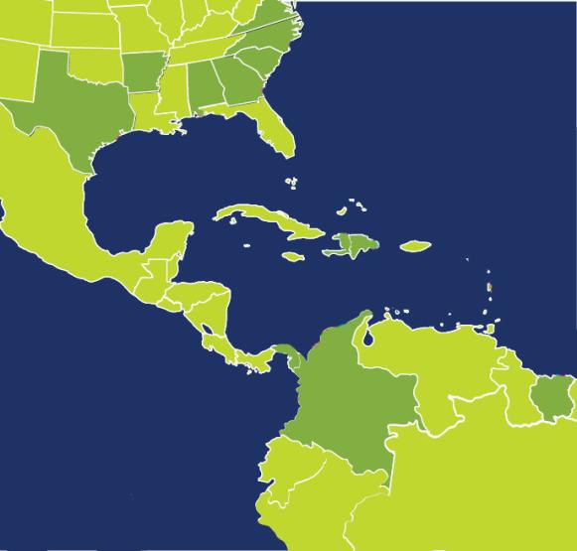
¿WHERE IS IT LOCATED?
SANTA MARTA
Population: 44 millions
Currency: Pesos
1 US Dollar = 2,500 PESOS
Exit upon 2 oceans : Atlantic (north) Pacific (east)
Notes:
-As most of you know, Colombia is located in the northwestern part of South America. Our currency is the Peso and one U.S. Dollar is equal to 2,500 Pesos.
-Our Income Per Capita according to National Planning is $5,000 U.S. Dollars and the total area of our country is 1,141,748 km².
-An interesting fact is that for every 100 km of the Americas, only 6 km belong to Colombia.
-On the other hand, we have a competitive advantage before the world, which is that we have coasts on both the Pacific and Atlantic Oceans. We also share borders with Venezuela, Peru, Ecuador and Brazil.

Slide 3
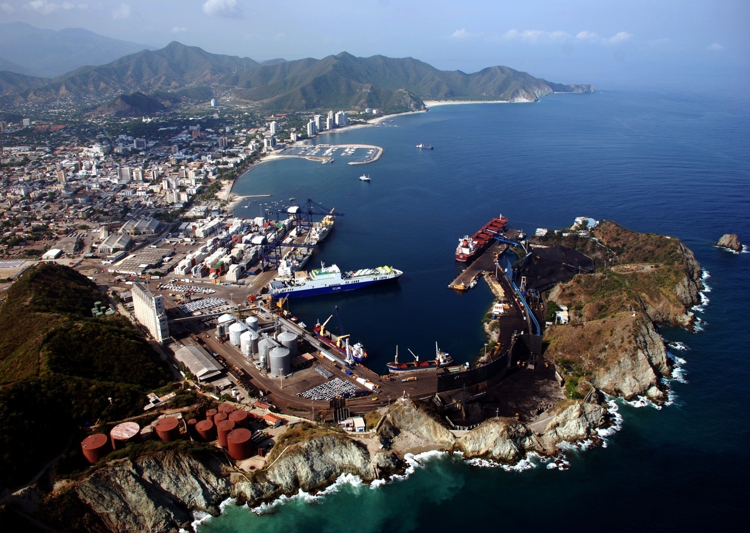
Notes:
As you may see in this image, our port is located in the center of the city of Santa Marta, and for this reason we are even more responsible of our port operations, having a great responsibility with present and future generations to provide them terminal operations in harmony with the city based on its dual vocation: tourism and port. Likewise, we are a port surrounded by natural resources as is the Tayrona National Park, a natural system formed by 21 tourist beaches, indigenous cultures such as the Arhuacos and Kankuamos, and surrounded by the Sierra Nevada of Santa Marta, the only mountain range in the world starting at sea level and going up to iced peaks as high as 5.000 meters, among others. People on our city demands development but in a sustainable way

Slide 4
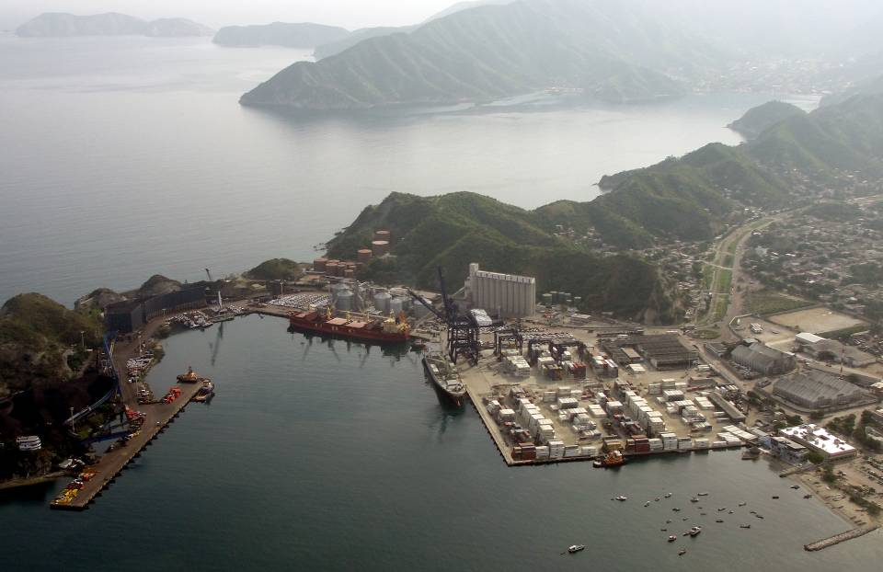
OUR PORT
COAL SUBTERMINAL
BULK AND GENERAL CARGO SUBTERMINAL
CONTAINERS SUBTERMINAL
Notes:
-we are a multipurpose Terminal divided into 3 big sub-terminals: the Container Sub-terminal in orange, Bulk and General Cargo Sub-terminal in yellow and the Coal Sub-Terminal in green.
-At SPSM, we have made commitments in the present and for the future to contribute to competitiveness and prosperity in the region.
-We generate 562 direct jobs and 8000 indirect jobs.

Slide 5
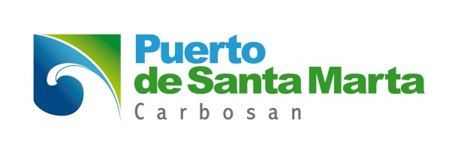
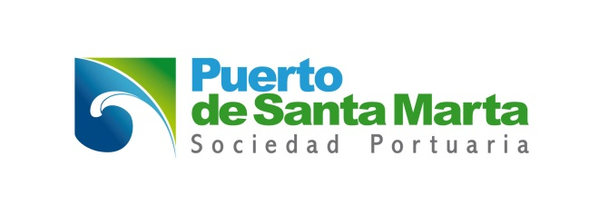
COAL SUBTERMINAL
COAL SUBTERMINAL
Notes:
Although our environmental management may be found in each and every corner of our port, on this occasion I would like to refer especially to what we do for our environment in our operation for the reception, collection and loading of coal, meeting the needs of the community to have an appropriate environment in a tourist town… but images are best than words so let us see these video….

Slide 6
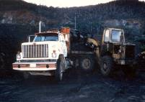
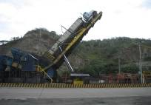
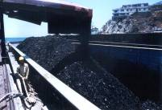
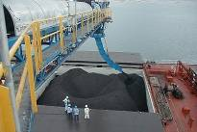
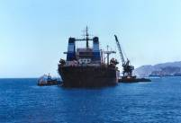
YESTERDAY
TODAY
Quality (ISO 9001) and environmental management (ISO 14001) certifications by SGS
Sustainable Operations
Implementation of the best environmental practices
Notes:
Previously, our operation in the coal subterminal took place in barges… since 2003 and after an investment of 27 million dollars, we implemented the direct loading system, anticipating by 10 years to decree 3083 of 2007 now existing in our country, which required that as of January 1st, 2013, all coal export terminals should have this system in operation, and we were 10 years ahead, thus generating the development of the city in a sustainable environment, and our example was taken by the central government and became mandatory at national level .

Slide 7
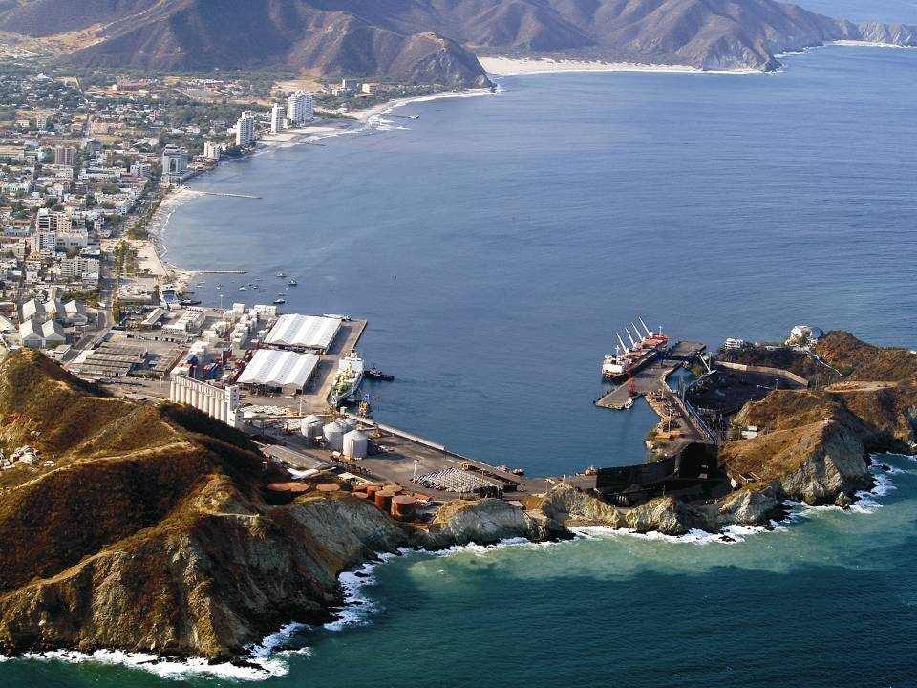
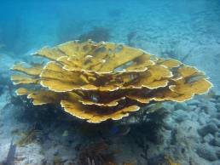
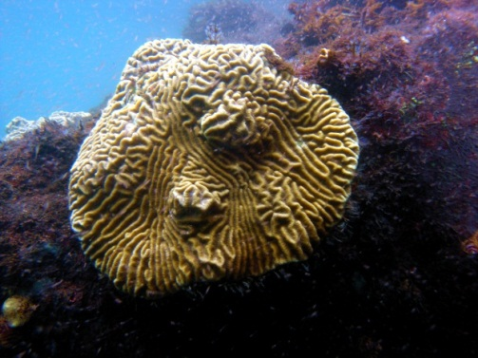
Protection of corals helps and promotes a healthy environment for fishing, facilitating the development of artisanal fishing that takes place in our bay.
Notes:
Proof of this is that thanks to our sustainable environmental operations, we may proudly show how at the dock where coal is loaded may be found the last relict coral existing in the entire bay of Santa Marta.
-At present it is an ecosystem protected thanks to port activity, based on sea safety regulations and fishery activities restricted at the Terminal. So, the ecosystem has not suffered the pressure of an excess exploitation; also, there are no drainage channels spilling contaminated waste, and it is located in a protected area of the bay where surf and hurricanes are not felt.

Slide 8
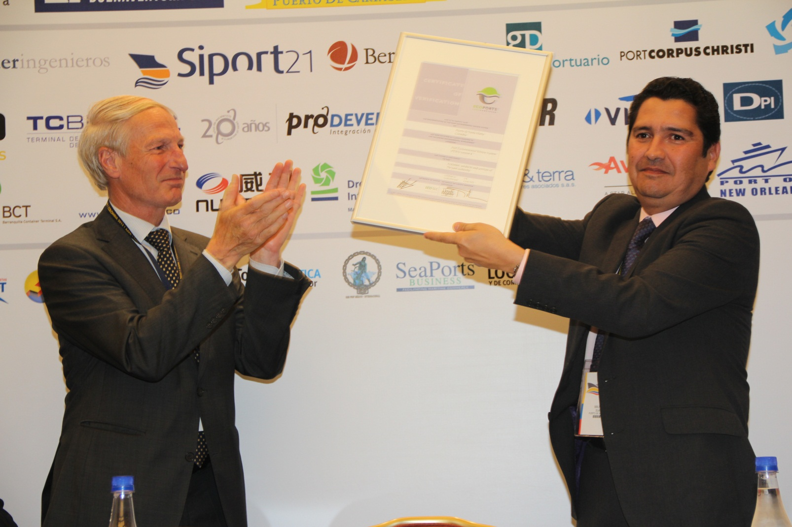
ECOPORTS CERTIFICATION
Notes:
And what has this management represented? In addition to ISO 9001 and ISO 1401 certifications that we have across the extent of it, in 2013 we were certified by LLOYDS REGISTER based in Amsterdam as ECOPORTS, certification that at the time acknowledged European terminals as environmentally sustainable. The Port of Santa Marta became the first port worldwide outside Europe to be certified as ECOPORTS. But what is ECOPORTS? Let us see…

Slide 9
VIDEO

Slide 10
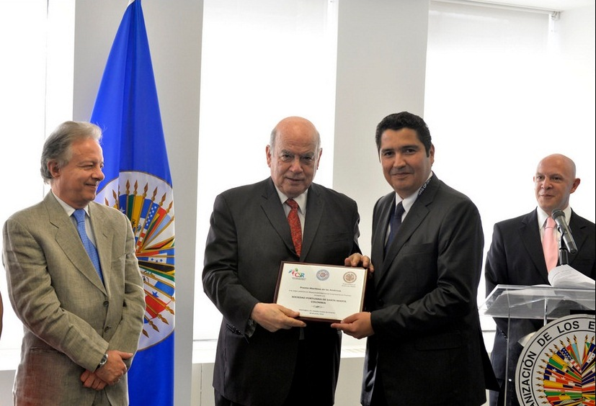
First prize of the americas
CATEGORY R.S.E
Notes:
Also, in June of 2014 we won the first maritime price of the Americas in the Corporate Social Responsibility category, which was presented to us by the General Secretary of OAS at that moment, Mr. José Miguel Insulza, here at OAS headquarters in Washington.

Slide 11
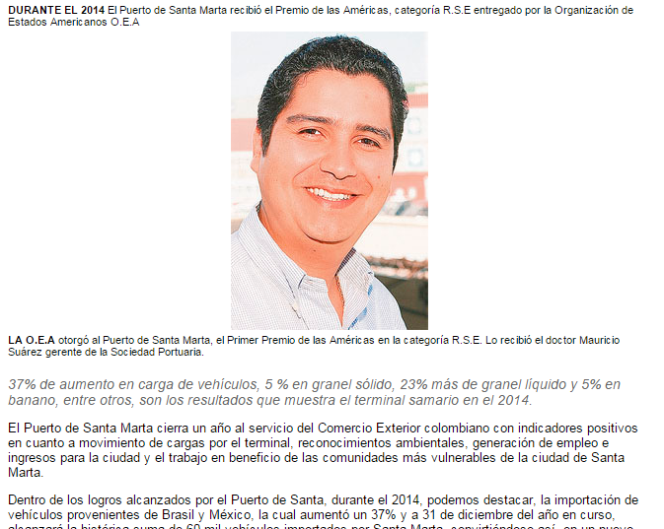
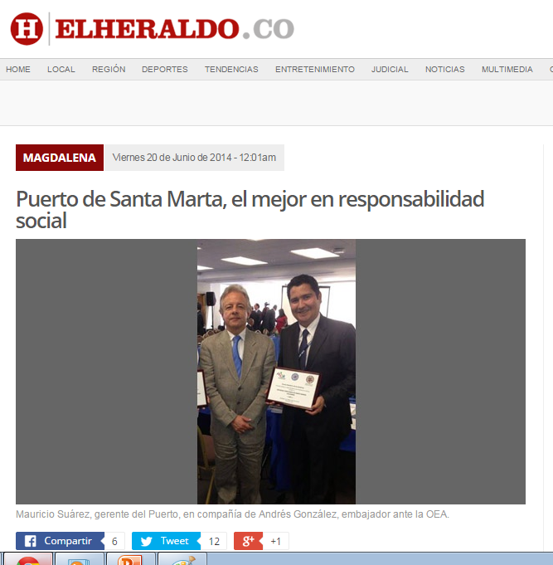
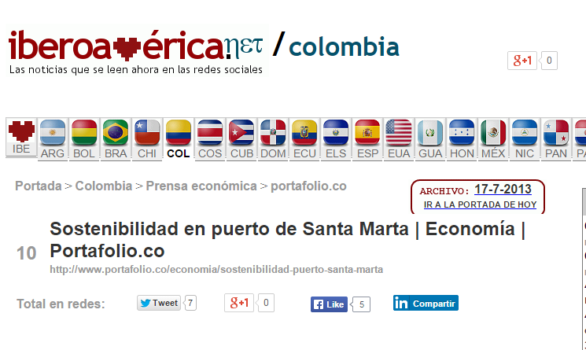
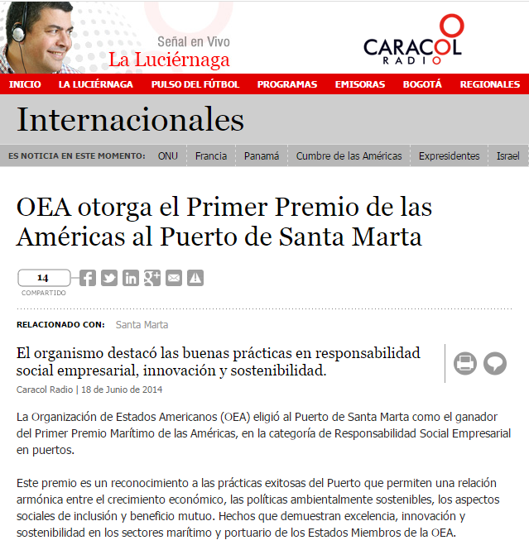
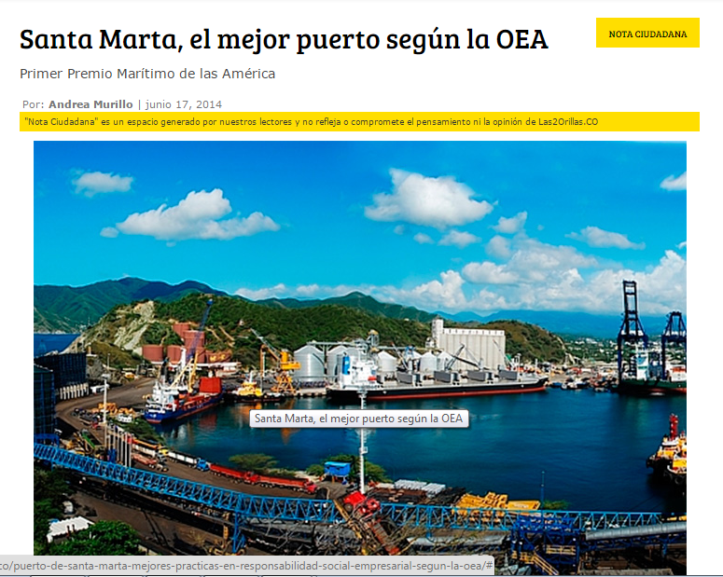
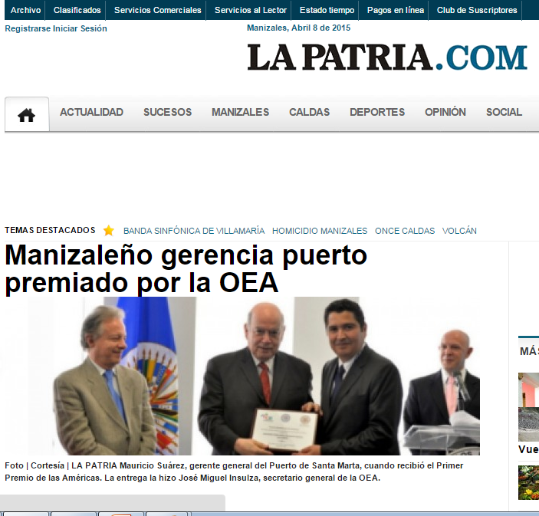
Notes:
Here you may see how the most important media of Colombia informed on the prize of the Americas of the OAS…. Some of the titles, as an example, say that “the port of Santa Marta is the best according to OAS”. OAS grants the prize of the Americas in Corporate Social Responsibility; “sustainability of Santa Marta is acknowledged by OAS”. AND FURTHERMORE, WHAT DO WE DO IN MATTERS OF COMMUNICATIONS??? LET US SEE…

Slide 12
VIDEO

Slide 13
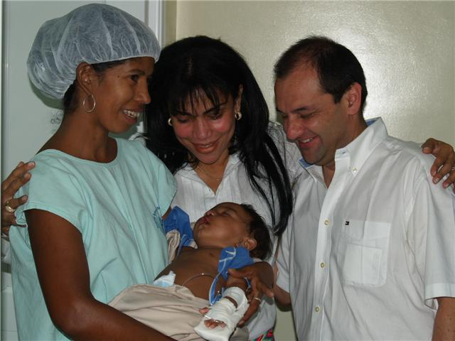
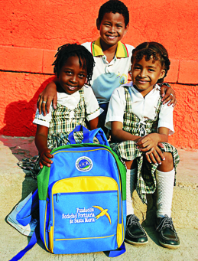
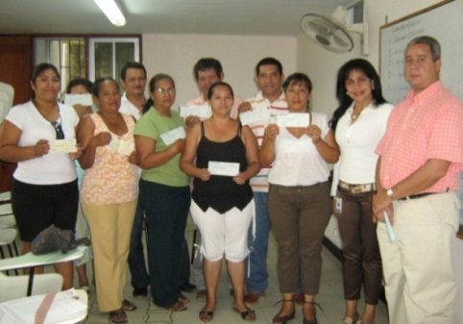
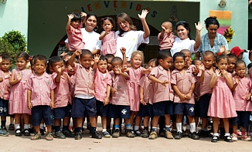
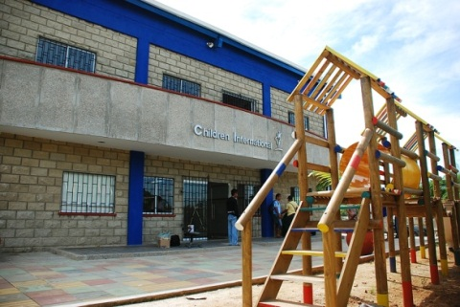
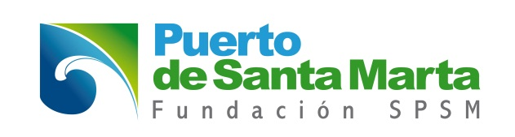
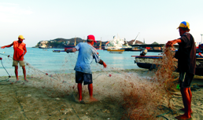
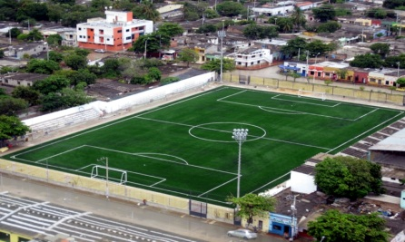
SOCIAL PROGRAMS
OPERATION SMILE PROGRAM
EDUCATION PROJECTS
MICROCREDIT PROGRAM
EARLY CHILDHOOD PROGRAM
INTERNATIONAL CHILDREN PROGRAM
FISHERS IN THE BAY
REMODELING SOCCER FIELD
LA CASTELLANA
Notes:
And finally, the work we develop through our foundation to which we provide, by order of our board of directors, up to 5% of annual profits to be invested in social projects for the most needy communities of the city, seeking to improve quality of life and education of children and youth. In the images you may see all the programs we have, such as operation smile, where we operate children with cleft palate and cleft lip; education programs in which we build libraries at the poorest schools of Santa Marta; microcredit programs for displaced and vulnerable population, making this a seed capital for a business that may improve their lives; programs for children through the administration of 5 homes of the Colombian Welfare Institute; work with fishers of the bay in labor competence, and remodeling parks and soccer fields.

Slide 14
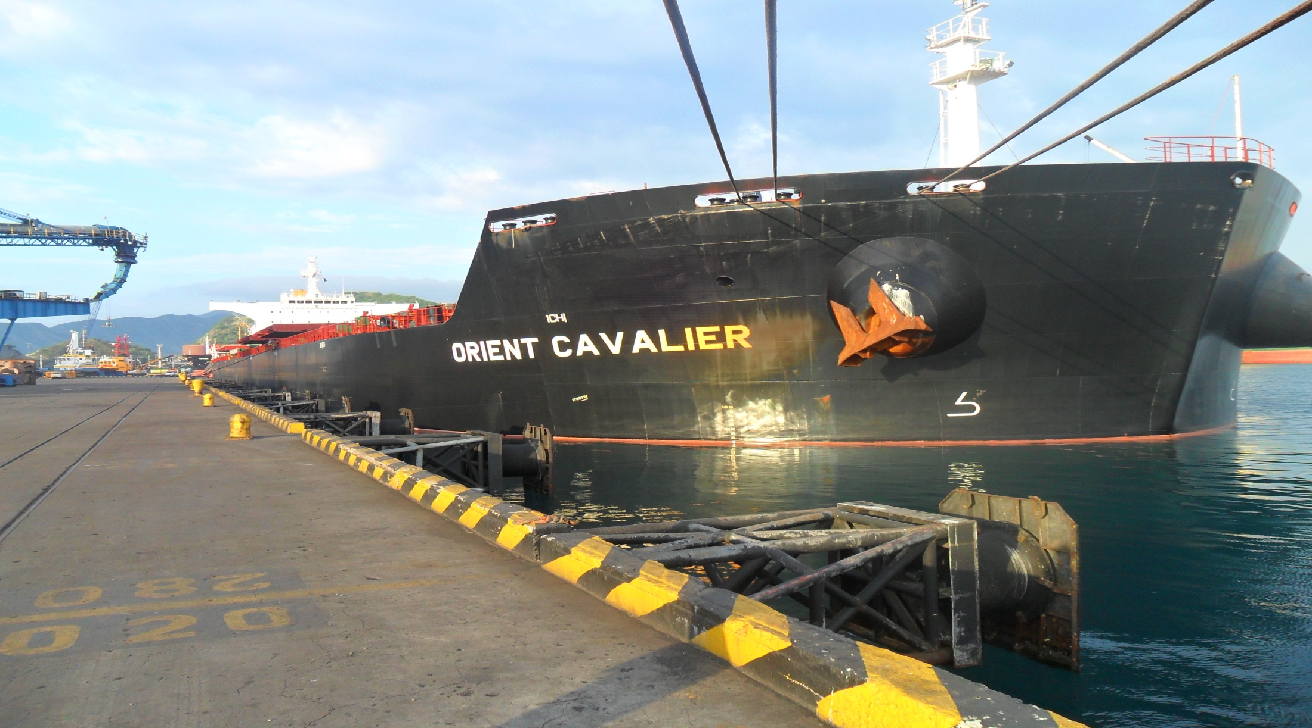
THANK YOU
CAMILO GEORGE
cgeorge@spsm.com.co
MAURICIO SUAREZ msuarez@spsm.com.co
Notes:
Now please be aware that you are cordially invited to visit our country, city and terminal so you may know first hand what we do in matters of port, environment and work with the communities, please rest assured you have an ally in Colombia…. Thank you

